Slide 1
DBMS Project Report Phase 2 and 3

Slide 2
CropKart An Online Auction System for Agricultural Products

Slide 3
BUSINESS RULES
Earnings:
Farmers And Buyers will have to pay an annual subscription fee to use the platform. Farmers will be charged less than buyers.

Slide 4
Operations:
Buyers can only bid on offers with a bid status as ‘OPEN’.
Once a bid is ‘CLOSED’ the product will be moved to the cart of corresponding buyer for payment and no longer be visible for auctions.
Once the bid is accepted, it is mandatory for the buyer to purchase and pay for the good.

Slide 5
CONCEPTUAL SCHEMA
A user can be either a farmer or a buyer (retailers/wholesalers or corporates)
User(Login_Id: string, Password: string, Name: string)
Farmer(Login_Id: string, Password: string, Name: string, IFSC: string, UID: string, Account_No: string, Start_date: date, End_date: date)
Buyer(Login_Id: string, Password: string, Name: String, UID: string, Start_date: date, End_date: date, Delivery_address: string)

Slide 6
Product(Product_Id: integer, Name: string, Description: string, Weight: integer, Min_Bid: integer, Category: string, Updated_on: timestamp, State: boolean)
Bill(Bill_Id: integer, Product_Description: string, Amount: integer, Farmer_uid: string, Buyer_uid: string, State: Boolean, Upadated_on: timestamp, Transaction_id: integer)
Message(Message_Id: integer, Text: string, Created_on: timestamp)

Slide 7
ENTITY RELATIONSHIP DIAGRAM

Slide 8
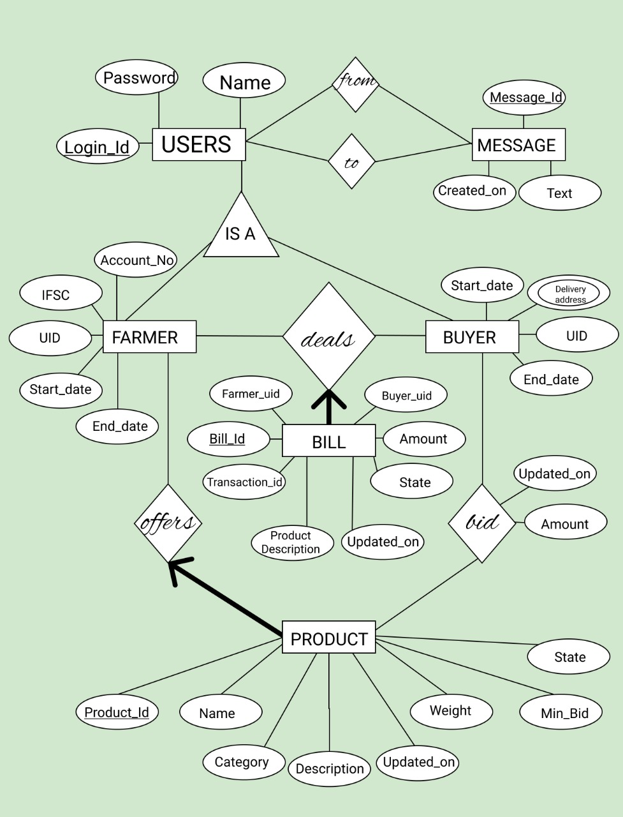

Slide 9
ER MODEL TO RELATIONAL MODEL
CREATE DATABASE Cropkart;

Slide 10
CREATE TABLE users(
loginID VARCHAR(20) NOT NULL,
Name VARCHAR(30) NOT NULL,
passwordkey VARCHAR(100) NOT
NULL,
PRIMARY KEY (loginID)
);

Slide 11
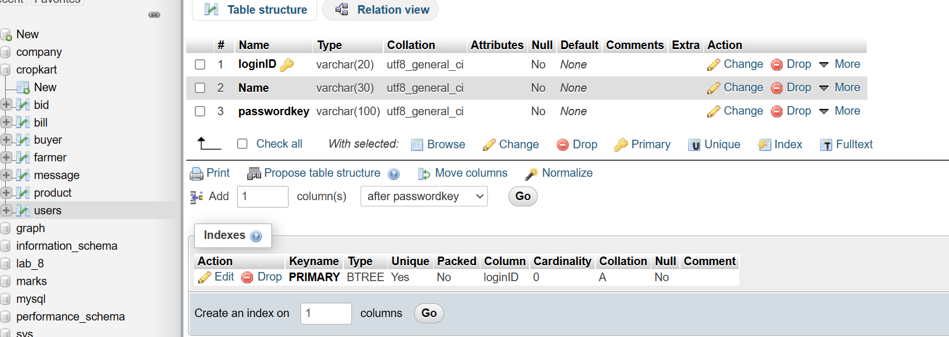

Slide 12
CREATE TABLE farmer(
loginID VARCHAR(20) NOT NULL,
UID VARCHAR(20) NOT NULL UNIQUE,
Acc_No VARCHAR(30) NOT NULL,
IFSC VARCHAR(20) NOT NULL,
startDate DATE NOT NULL,
endDate DATE NOT NULL,
PRIMARY KEY (loginID),
CONSTRAINT userRef FOREIGN KEY
(loginID) REFERENCES users(loginID) ON
DELETE CASCADE ON UPDATE CASCADE
);

Slide 13
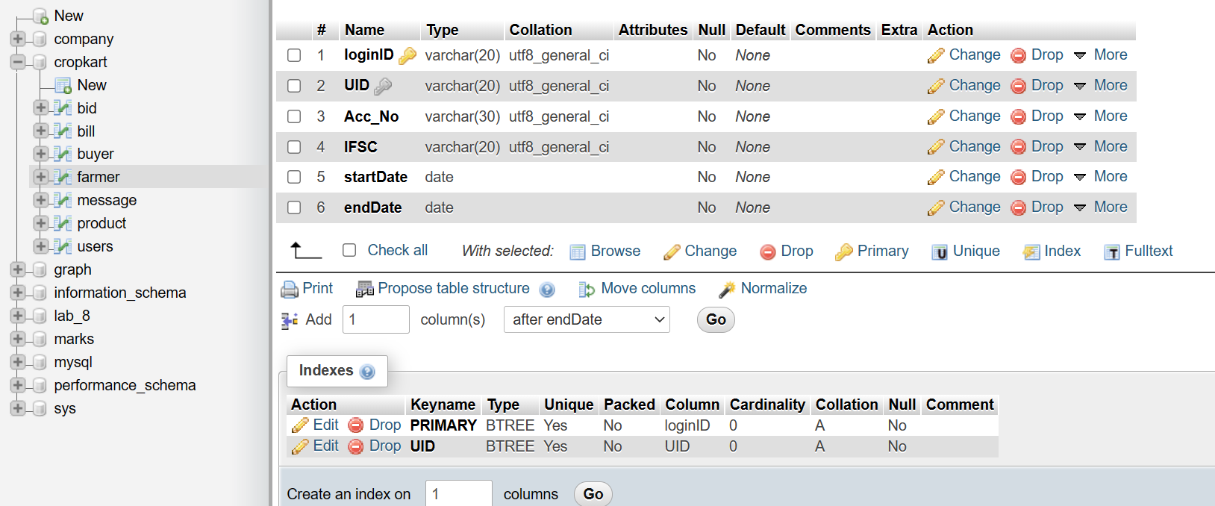

Slide 14
CREATE TABLE buyer(
loginID VARCHAR(20) NOT NULL,
UID VARCHAR(20) NOT NULL UNIQUE,
startDate DATE NOT NULL,
endDate DATE NOT NULL,
PRIMARY KEY (loginID),
CONSTRAINT buyerRef FOREIGN KEY
(loginID) REFERENCES users(loginID)
ON DELETE CASCADE
ON UPDATE CASCADE
);

Slide 15
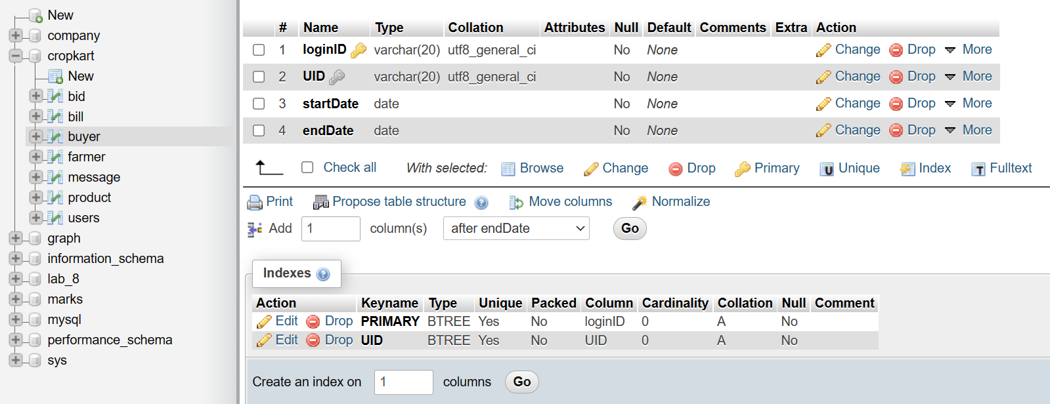

Slide 16
CREATE TABLE delivery_address(
delivery_id BIGINT AUTO_INCREMENT,
loginID VARCHAR(20) NOT NULL,
Location VARCHAR(30) NOT NULL,
PRIMARY KEY (delivery_id),
CONSTRAINT addressRef FOREIGN KEY (loginID) REFERENCES buyer(loginID)
ON DELETE CASCADE
ON UPDATE CASCADE
);

Slide 17
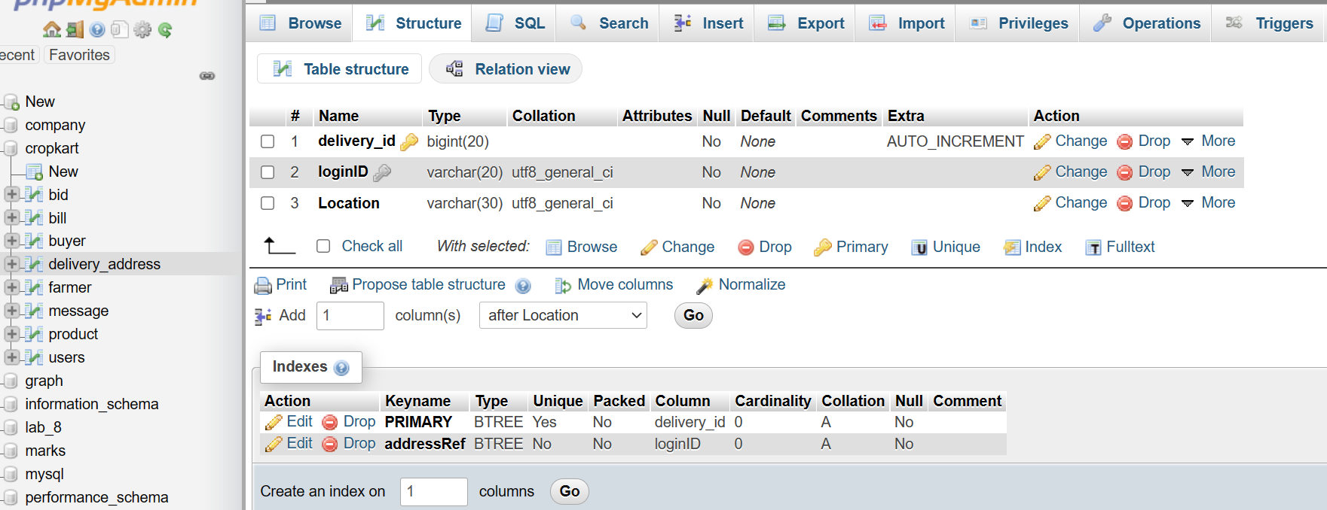

Slide 18
CREATE TABLE MESSAGE(
message_id BIGINT AUTO_INCREMENT,
text VARCHAR(15000) NOT NULL,
from_id VARCHAR(20) NOT NULL,
to_id VARCHAR(20) NOT NULL,
created_on timestamp NOT NULL
DEFAULT CURRENT_TIMESTAMP,
PRIMARY KEY (message_id),
CONSTRAINT _from FOREIGN KEY
(from_id) REFERENCES
users(loginID),
CONSTRAINT _to FOREIGN KEY
(to_id) REFERENCES users(loginID)
);

Slide 19
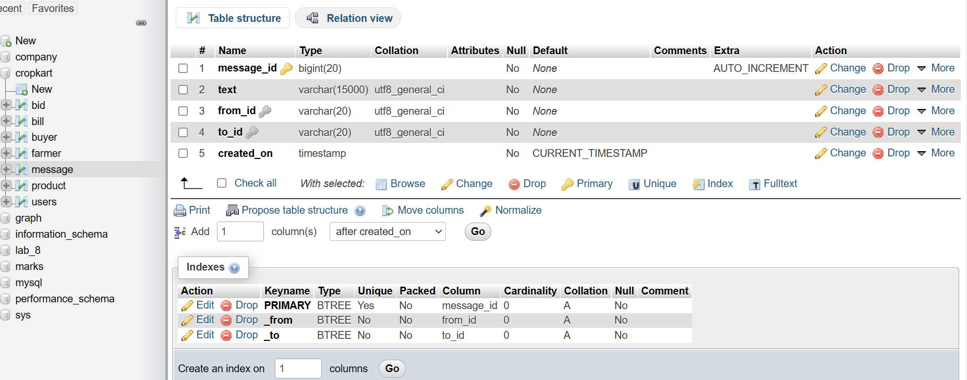

Slide 20
CREATE TABLE product(
farmerid VARCHAR(20) NOT NULL,
productid BIGINT AUTO_INCREMENT,
name VARCHAR(40) NOT NULL,
description VARCHAR(10000) NOT NULL,
state BOOLEAN DEFAULT ‘1’,
weight INT NOT NULL,
min_bid INT NOT NULL,
category VARCHAR(20) NOT NULL,
updated_on TIMESTAMP,
PRIMARY KEY (productid),
CONSTRAINT uniprod UNIQUE (farmerid, productid),
CONSTRAINT farmer FOREIGN KEY (farmerid)
REFERENCES farmer(loginID) ON DELETE CASCADE
);

Slide 21
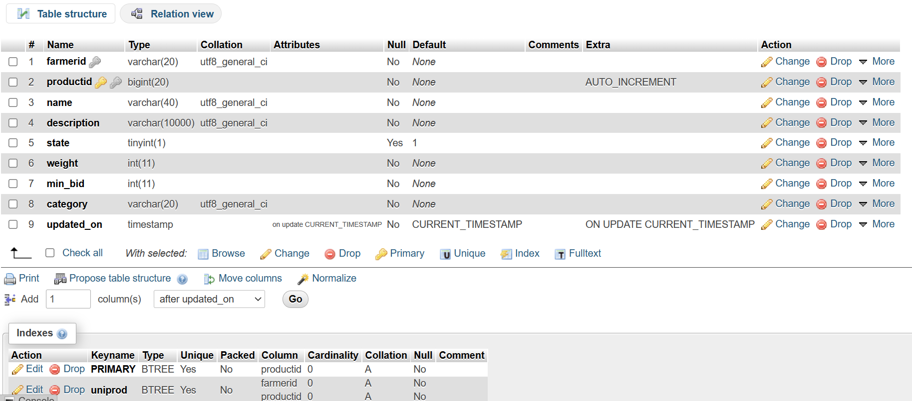

Slide 22
CREATE TABLE bid(
farmerid VARCHAR(20) NOT NULL,
productid BIGINT NOT NULL,
buyerid VARCHAR(20) NOT NULL,
amt INT NOT NULL,
updated_on TIMESTAMP,
PRIMARY KEY (productid, buyerid),
CONSTRAINT prod FOREIGN KEY (productid) REFERENCES
product(productid) ON DELETE CASCADE,
CONSTRAINT buyer FOREIGN KEY (buyerid) REFERENCES
buyer(loginID) ON DELETE CASCADE
);

Slide 23
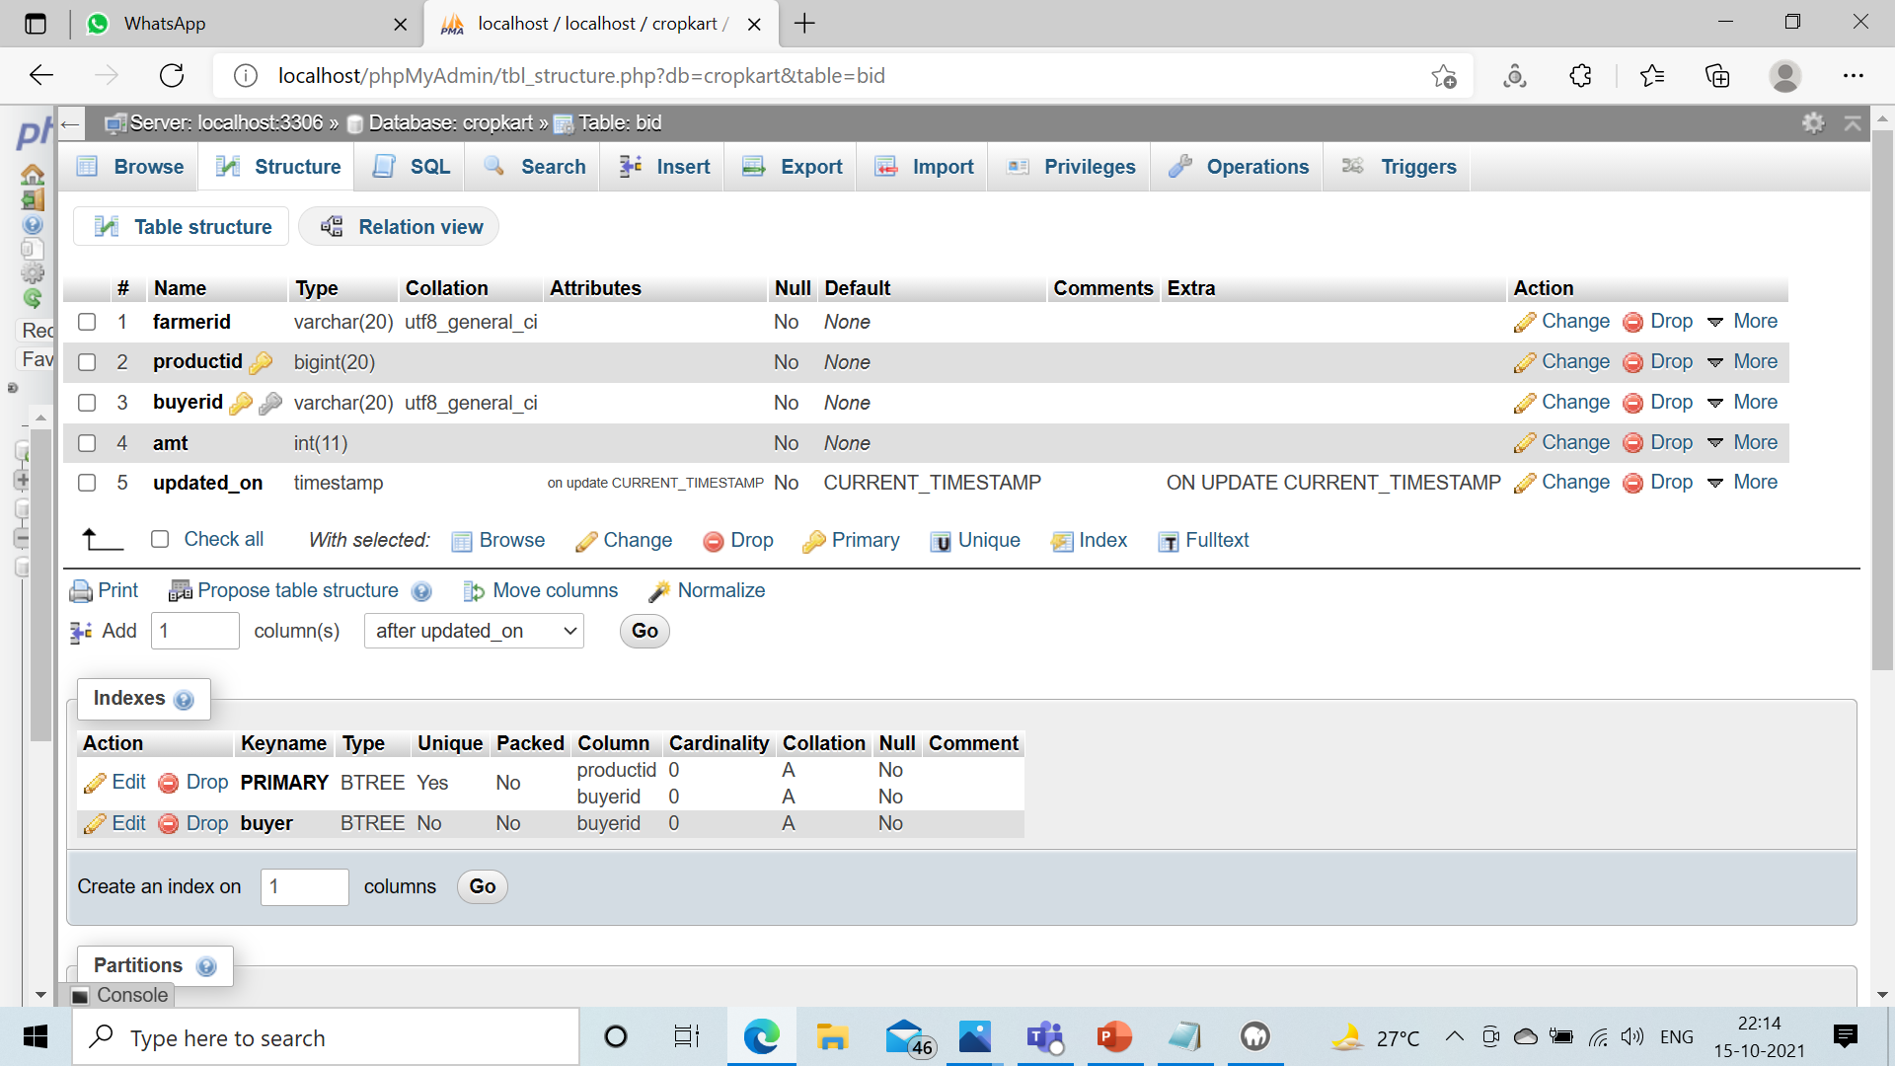

Slide 24
CREATING TRIGGER TO ENFORCE BUSINESS RULE
DELIMITER //
CREATE TRIGGER bidcheck
BEFORE INSERT on bid
FOR EACH ROW
BEGIN
if(NOT EXISTS(SELECT P.productid
from product P WHERE P.productid = new.productid
AND P.state = 1)) THEN
SIGNAL SQLSTATE '45000' SET
MESSAGE_TEXT = 'Auction is closed!!!';
END IF;
END; //
DELIMITER ;

Slide 25
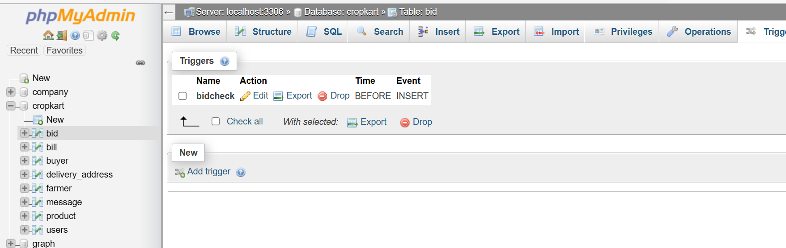

Slide 26
CREATE TABLE bill(
billid BIGINT AUTO_INCREMENT,
updated_on TIMESTAMP,
product_description VARCHAR(10000) NOT NULL,
transactionid VARCHAR(30),
state BOOLEAN DEFAULT '0',
amount INT NOT NULL,
farmerid VARCHAR(20),
buyerid VARCHAR(20),
farmeruid VARCHAR(20) NOT NULL,
buyeruid VARCHAR(20) NOT NULL,
PRIMARY KEY (billid),
CONSTRAINT farmer_ FOREIGN KEY (farmerid) REFERENCES
farmer(loginID) ON DELETE SET NULL,
CONSTRAINT buyer_ FOREIGN KEY (buyerid) REFERENCES
buyer(loginID) ON DELETE SET NULL
);

Slide 27
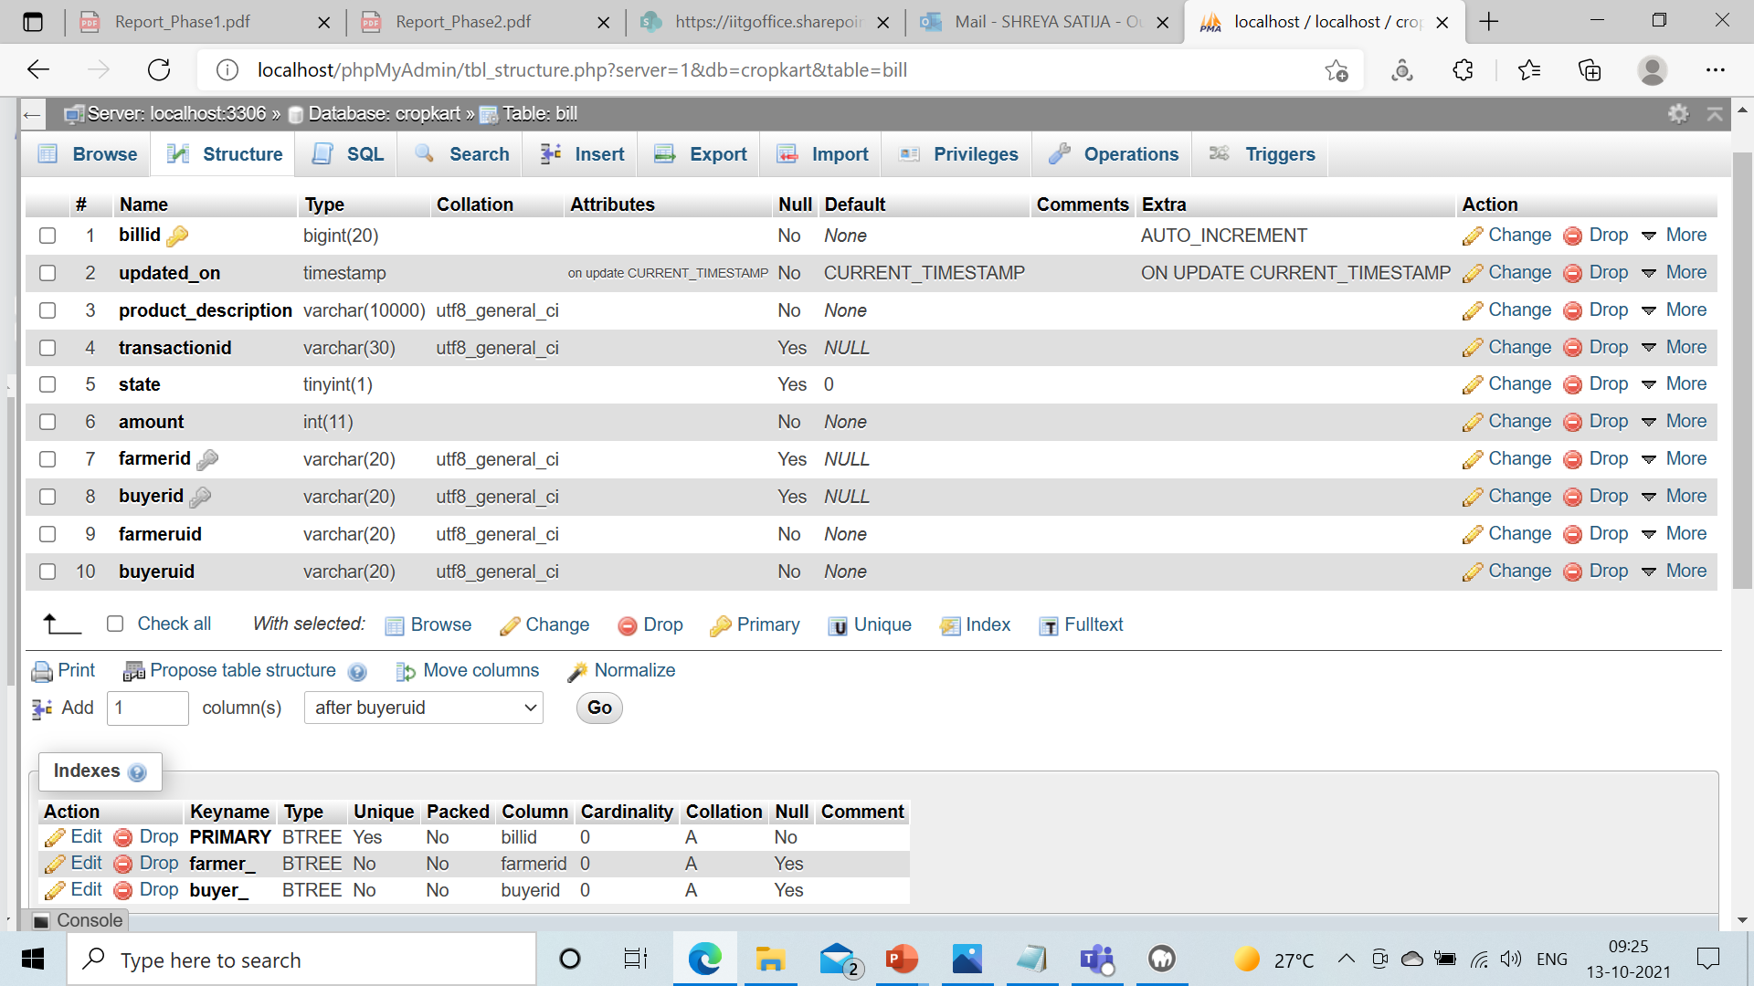

Slide 28
ENFORCING BUSINESS RULES
Subscription Start_date and End_date have been added for both Farmer and Buyer entities.
State of a bid ensures that whether a bid is ‘OPEN’ or ‘CLOSED’. If a bid is ‘CLOSED’, then the product will not be listed for auction.
Once the bid state is ‘CLOSED’, we will use trigger to move the corresponding product to Buyer’s cart.

Slide 29
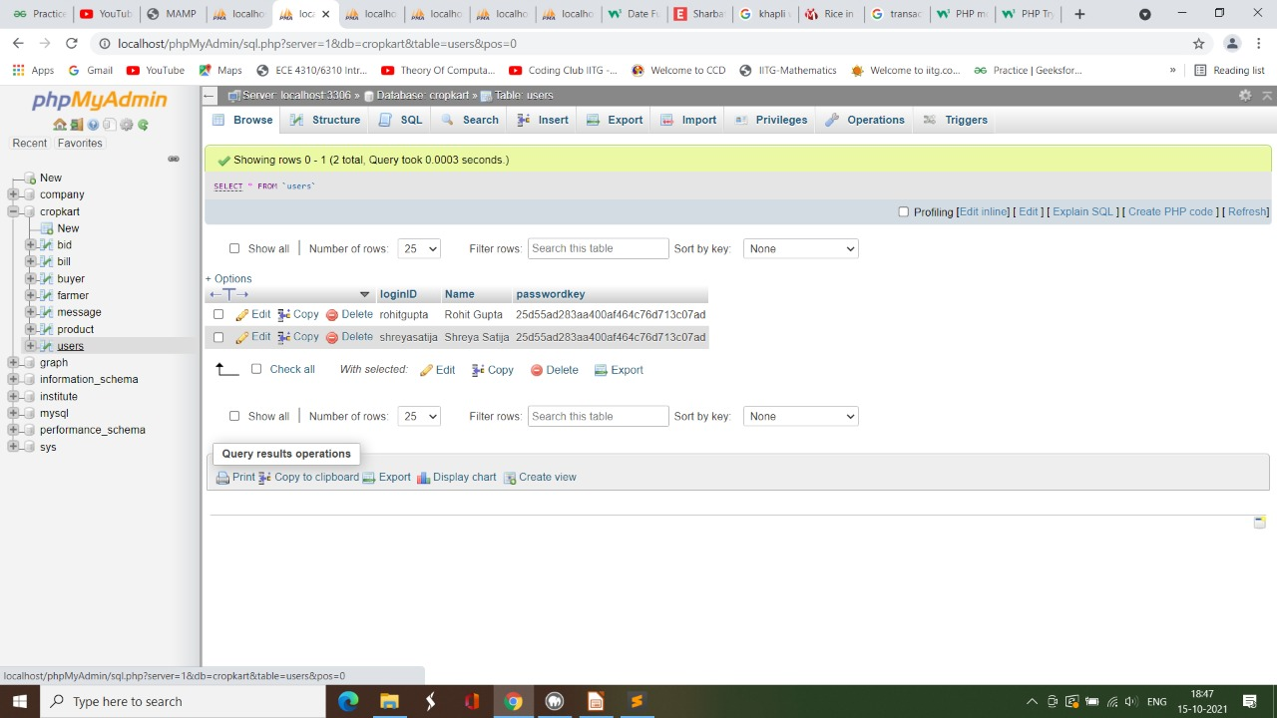
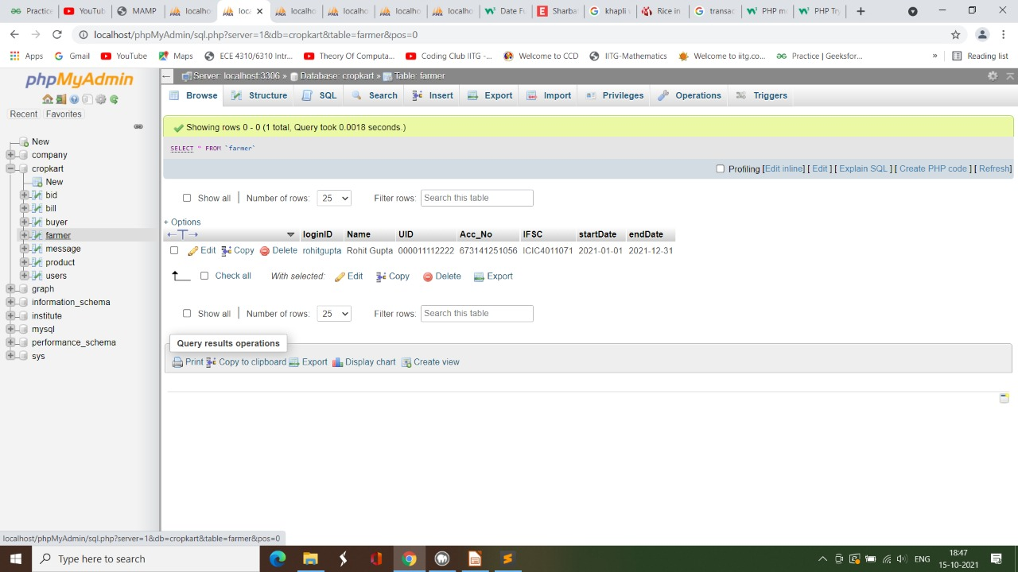
POPULATING TABLES

Slide 30
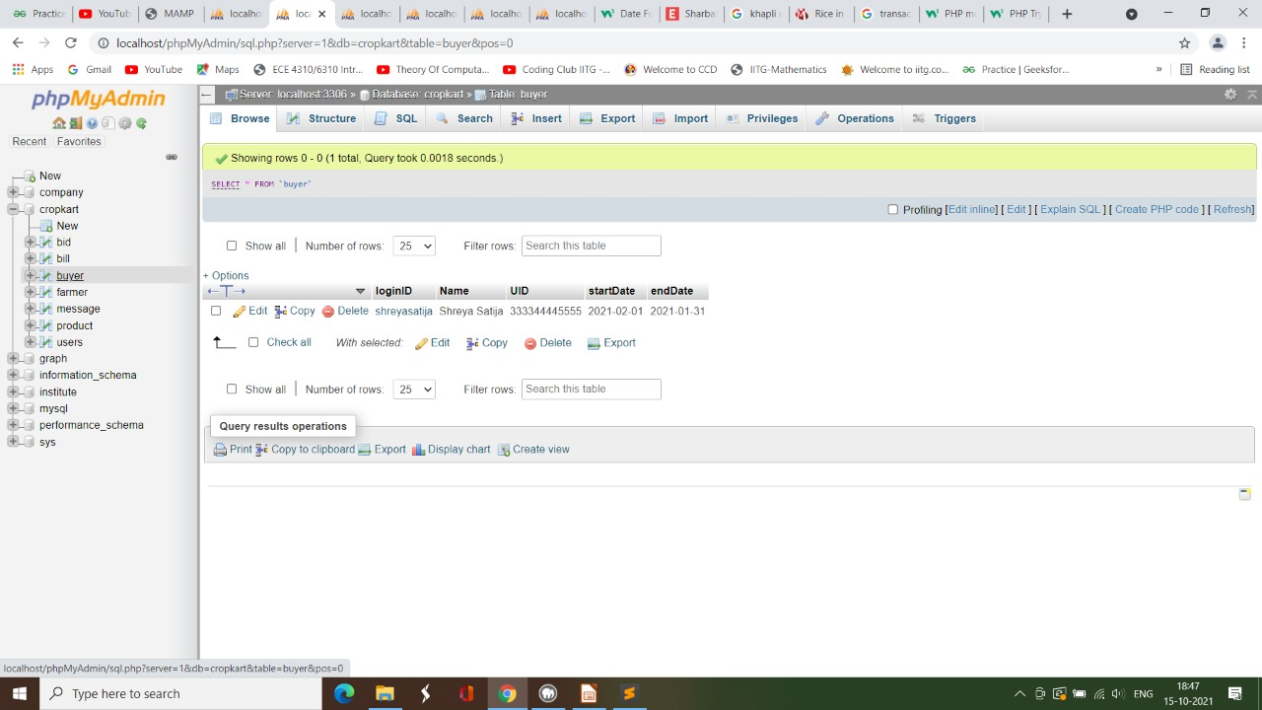
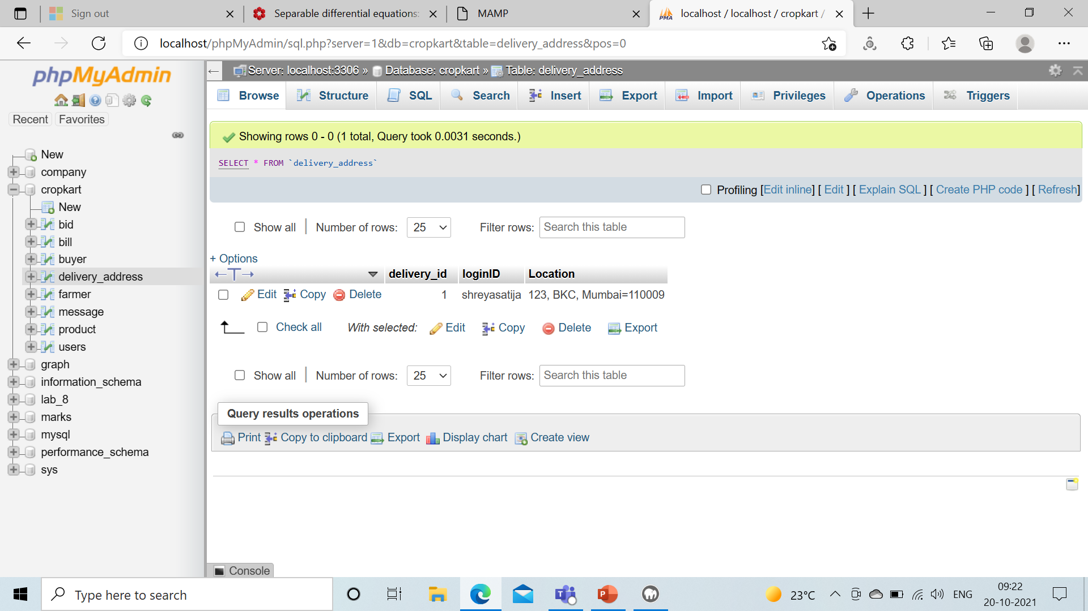


Slide 31
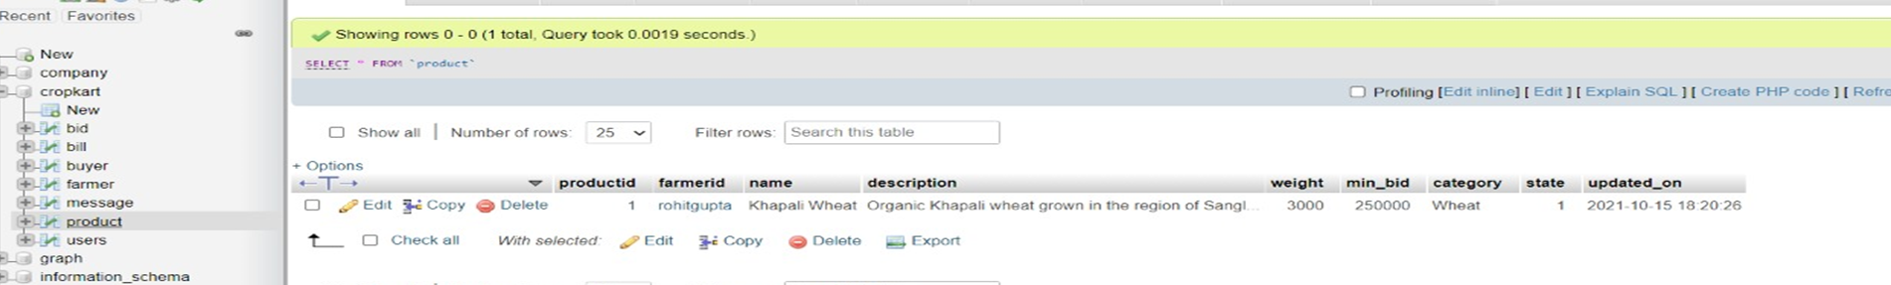
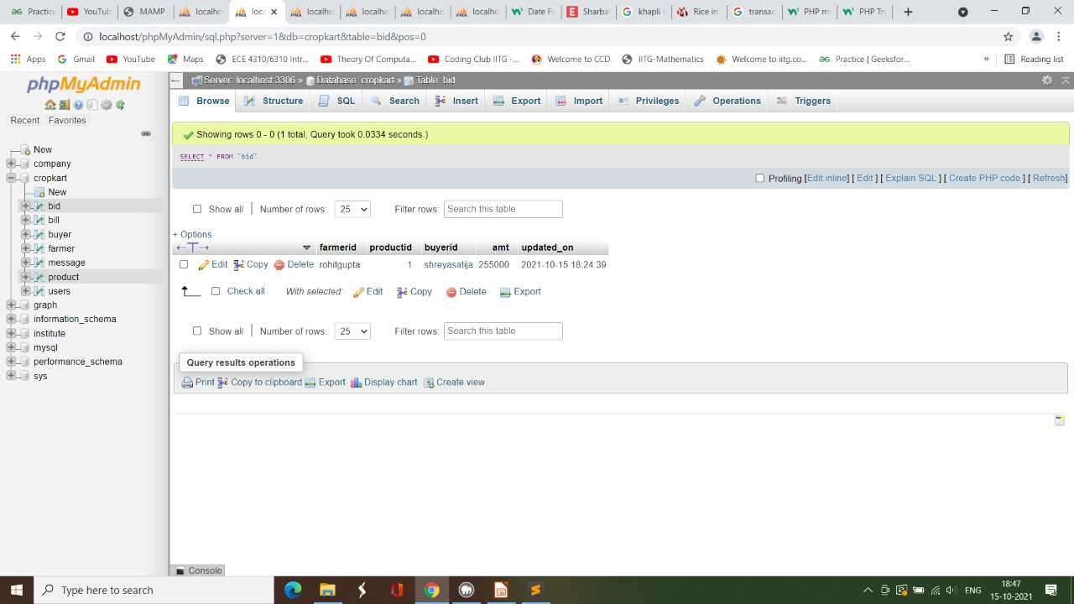
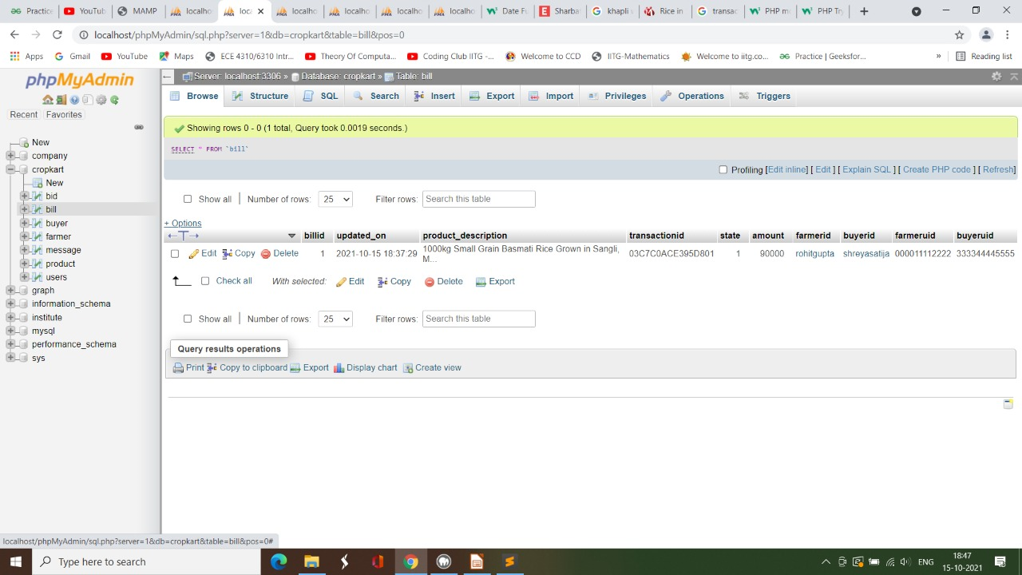

Slide 32
THANK YOU

